Slide 1
Entity (Framework) and LINQ to Entity (Framework)
Review for ISIT 420

Slide 2
LINQ (LINQ to SQL) or Entity Framework
Entity Framework is more targeted towards Enterprise Development where the schema is usually optimized for storage considerations like performance consistency and partitioning.
Entity Framework is designed around exposing an application-oriented data model that is loosely coupled and may differ from the existing database schema. For example, you can map a single entity (class) to multiple tables or map multiple entities to the same table.
Entity Framework has “.edmx” (ADO.NET Entity Model) file when added in the application.
LINQ to SQL mainly has features to support Rapid Application Development against SQL Server. LINQ to SQL allows you to have a strongly typed view of your existing database schema. You can build LINQ queries over tables and return results as strong typed objects.
LINQ to SQL has “.dbml”(LINQ to SQL) file when added in the application.
http://totaldotnet.com/article/showarticle54_difflinqentity.aspx

Slide 3
What is the entity framework?
Entity framework is an Object/Relational Mapping (O/RM) framework. It is an enhancement to ADO.NET that gives developers an automated mechanism beyond the DataReader and DataSet for accessing & storing the data in the database and working with the results.
ORM is a tool for storing data from domain objects to relational database in an automated way without much programming.
O/RM includes three main parts:
Domain class objects,
Relational database objects and
Mapping information on how domain objects maps to relational database objects (tables, views & storedprocedures).
ORM helps us to keep our database design separate from our domain class design.
This makes application maintainable and extendable.
It also automates the standard CRUD operations (Create, Read, Update & Delete) so developer doesn’t need to write it manually.
http://www.entityframeworktutorial.net/EntityFramework4.3/Introduction.aspx
Uses this DB https://msdn.microsoft.com/en-us/library/jj614587(v=vs.113).aspx

Slide 4
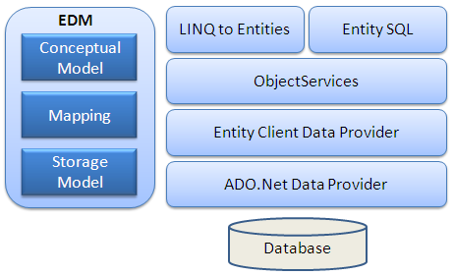
Entity Framework Architecture
EDM (Entity Data Model): EDM consist three main parts:
Conceptual Model: Conceptual model is your model classes and their relationships. This will be independent from your database table design.
Storage Model: Storage model is your database design model which includes tables, views, stored procedures and their relationships and keys.
Mapping: Mapping consist information about how your conceptual model is mapped to storage model.
LINQ to Entities: LINQ to Entities is query language used to write queries against the object model. It returns entities which are defined in the conceptual model. You can use your LINQ skills here.
Entity SQL: Entity SQL is again a query language same as LINQ to Entities. However it is little more difficult than L2E and also developer need to learn it separately.
Object Service: Object service is a main entry point for accessing data from database and to return it back. Object service is responsible for materialization which is process of converting data returned from entity client data provider (next layer) to an entity object structure.
Entity Client Data Provider: The main responsibility of this layer is to convert L2E or Entity SQL queries into SQL query which is understood by underlying database. It communicates with ADO.Net data provider which in turn sends or retrieves data from database.
ADO.Net Data Provider: This layer communicates with database using standard ADO.Net.

Slide 5
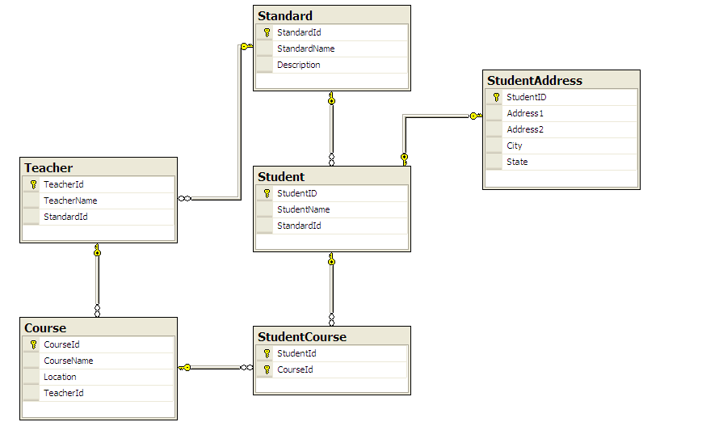
One-to-One: Student and StudentAddress has one-to-one relationship eg. Student has zero or one StudentAddress.
One-to-Many: Standard and Teacher has one-to-many relationship eg. many Teachers can be associate with one Standard.
Many-to-Many: Student and Course has many-to-many relationship using StudentCourse table where StudentCourse table includes StudentId and CourseId. So one student can join many courses and one course also can have many students.

Slide 6
LINQ to SQL is tightly coupled - object property to specific field of database or more correctly object mapping to a specific database schema
LINQ to SQL only supports 1 to 1 mapping of the database tables, views, sprocs and functions available in MS SQL Server
LINQ to Entities is an ORM (Object Relational Mapper) API which allows for a broad definition of object domain models and their relationships to many different ADO.Net data providers.
you can mix and match a number of different database vendors, application servers or protocols to design an aggregated mash-up of objects which are constructed from a variety of tables, sources, services, etc
EF allows mapping a single class to multiple tables
EF handle Many to Many relationships
EF has the ability to target any ADO.NET data provider

Slide 7
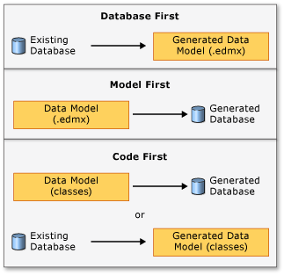
3 ways you to work with data models and databases https://msdn.microsoft.com/en-us/library/ms178359.aspx#dbfmfcf
Database First - If already have database, Entity Framework designer in VS can auto-generate a data model (classes and properties corresponding to database objects such as tables and columns.
Model First - create model in an .edmx file using the Entity Framework graphical designer in VS. (designer generates data definition language statements to create the database)
Code First - code your own classes and properties. Entity Framework tools can generate the DB tables and columns.

